Slide 1
Pastoralist in the Modern World

Slide 2
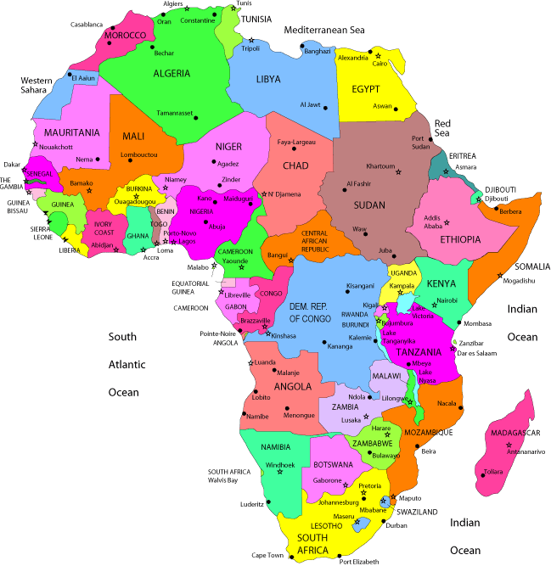
Pastoralism in Africa
About 22 million people are involved in pastoral activity.
Among them are Bedouins, Berbers, Maasai, Somali, Boran and Turkan are prominent.
They raise cattle, camels, goats, sheeps and donkeys as well as sell milk, meat, animal’s skin and wool.
Some are also combining pastoral activity with agriculture, trade, transport and other odd jobs to sustain their life.

Slide 3
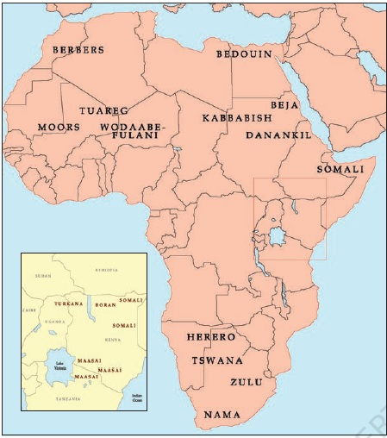
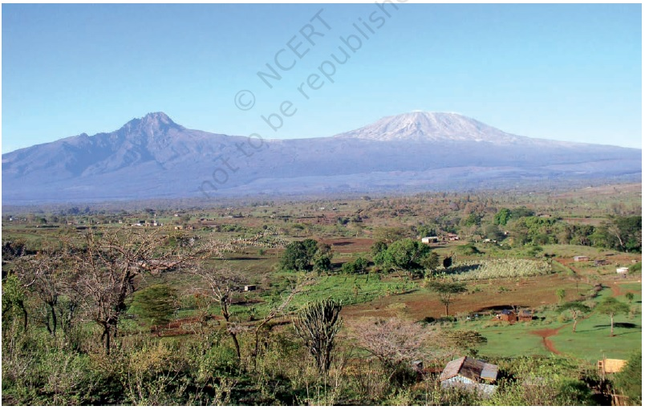
The Maasai tribe
The Maa-sai, meaning “My People” are found in East Africa (Sothern Kenya & Tanzania) are primarily cattle herders.
In 19th century after a fight for territory among different European powers in Africa the area of Maasai land was divided into different colonies.
The best grazing land of this area became white settlements, cultivated land, national parks (Samburu & Amboseli in Kenya and Serengeti park in Tanzania) and games reserve ( Maasai Mara in Kenya).

Slide 4
Impact of Colonialism on Maasai Pastoralist
Loss of grazing land for their livestock.
Their movement restricted, confined to a fixed area and in special reserves.
Continuous grazing in a specific area led to the deterioration of quality pastures.
Shortages of pasture during droughts led to ill-health, disease and death of animal flock in large number.
Colonial rule also affected the tradition of Maasai society.

Slide 5
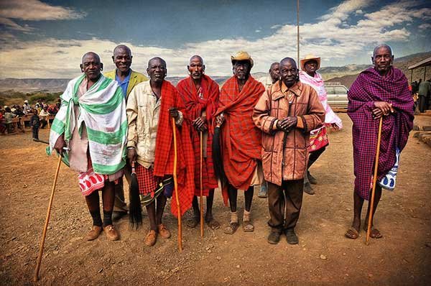
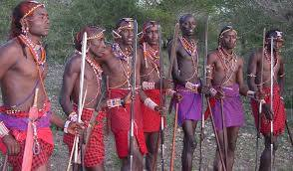
The Maasai Society
- Traditionally divided into two groups as Elders and Warriors.
The Elders formed the ruling group, exercised authority, decide the community affairs and settle disputes.
The Warriors consisted with the young man used to defend the community and organise cattle raids on other.

Slide 6
Changes on Maasai Society under Colonialism
The British colonial authorities interfered in the traditional affairs of Maasai.
In order to administer their affairs new chiefs of various sub groups were appointed.
These chiefs were rich and also had both pastoral and non pastoral income and therefore remain unaffected during crisis and drought.
The poor pastoralists were affected by colonial policies, droughts, famine and war and finally pushed to the labour market.

Slide 7
Changes in Maasai Society after Colonial Rule
The traditional difference, based on age between the elders and the warriors was disturbed.
In new distinction between the rich & poor pastoralist developed.

Slide 8
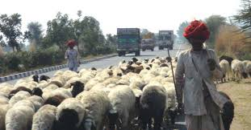
CONCLUSION
To sum up
Pastoralism was indeed a way of life and an economic activity which has its relevance even in modern times in many hilly and dry regions of India as well as the world.
Though colonialism attempted to push them to oblivion but their tradition and timely movements keeps them and their profession at a centre stage of attention and attraction for study by the researchers and environmentalists in modern times.

